Slide 1

WELCOME
TEAM ASNN

Slide 2
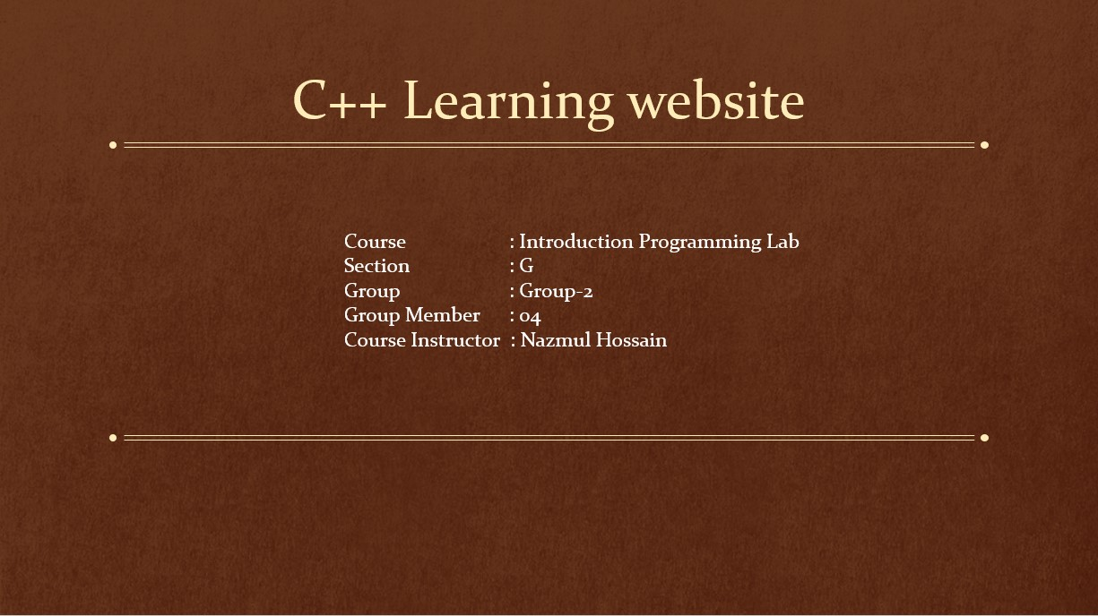

Slide 3

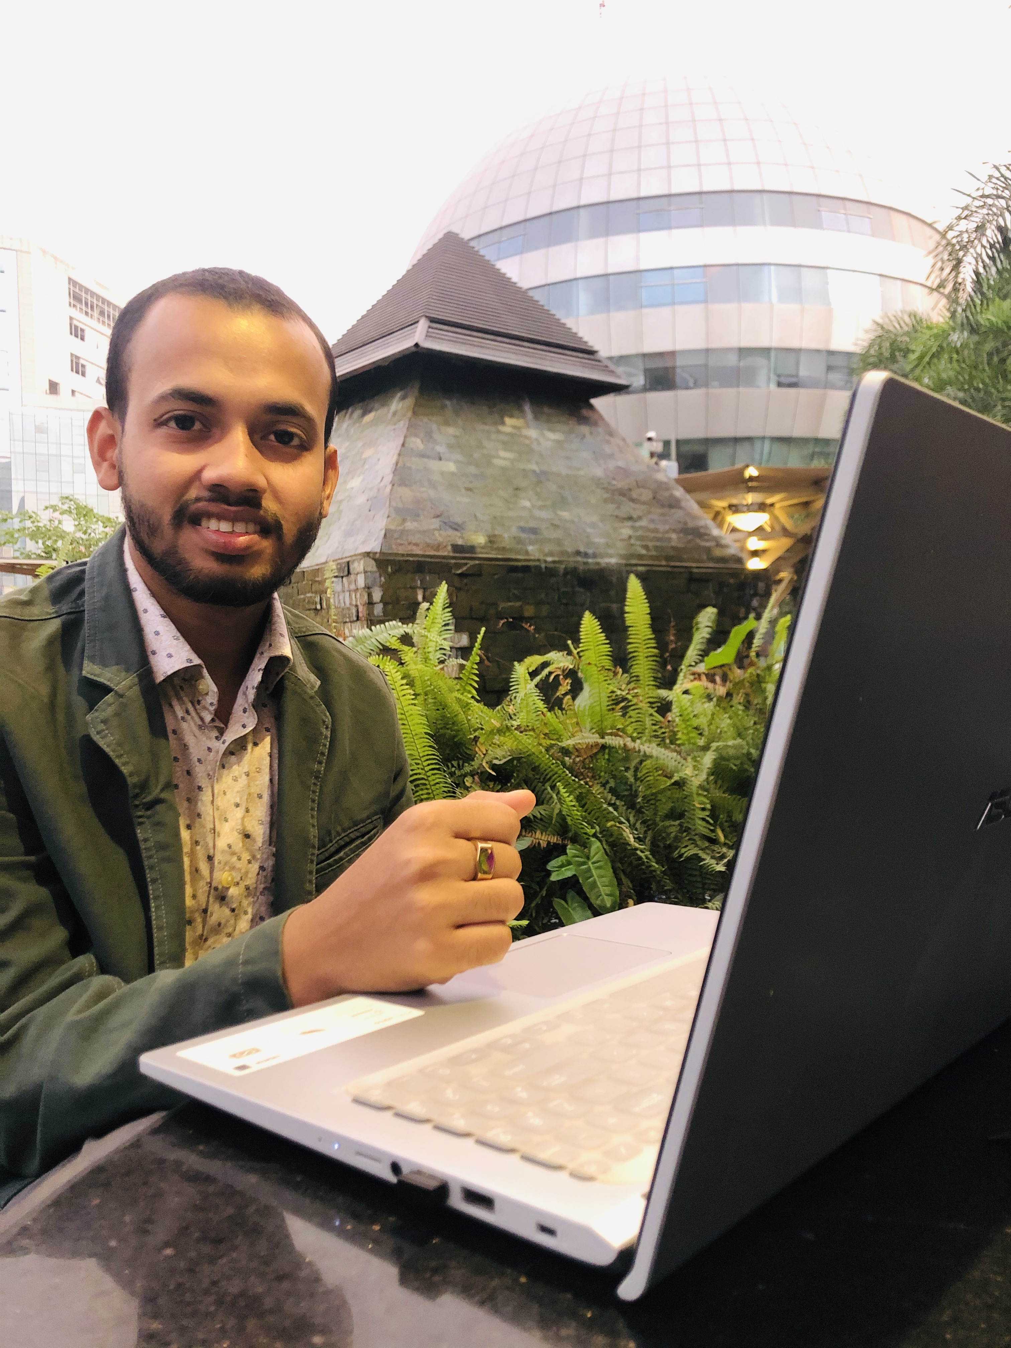

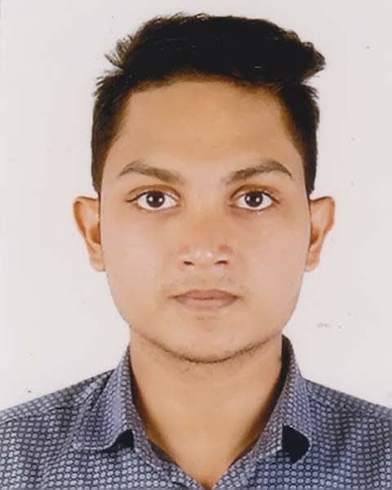
Profile
NAHIDA ASHA ID : 19-41190-3
SADIA KHANAM ID : 20-44005-2
NESAR UDDIN 19-41759-3
ASGOR REAJ ID : 20-43999-2

Slide 4
Project Motto
C++ is one of the most used Programming Languages in the world. In this 21st century, programming playing very important roll in our life. We have been using it for our own need since 1980.
Many people want to learn C++ languages but they fail for not getting proper direction. In TeamASNN Website, we added many different features so that user can easily use it for their needs. There are 30 index in different topics. From Hello world to object-oriented programming, user can learn anything such as Arrays, Loop, Functions etc.
After learning any topic, user can give quiz.Before login, User have to register his mail to give quiz. After givingquiz, user get to know right answers. For Grading system,user get to know his total marks. For giving quiz, we give a Certificate to the user.
In our website, there are also many live demo codes. User can run it or if they are stuck in any other place this type of live-demo codes helps a lot
Another important thing is : For Beginners our site is really useful because we designed the website that way. So that we can satisfy every users need. Users basic will be clear after learning C++.

Slide 5





Main Portion
WEL
COME
HOME
QUIZ
GRADE
WELCOME
HOME
QUIZ
GRADING
After complete the quiz section then you can see the grade of your recent completed quiz.
Our Program shows a welcome message firstly with our Team Name (TEAM ASNN )
In our Home page, There has almost 30 numbers of index. Every index connected each others.
It’s the most attractive things in our Project. You can check your knowledge about C++ by a simple quiz.

Slide 6
WHY CHOOSE US !!!
1
Solved programs with output
and Explanation in C++.
8
You also find a quiz section for
Check your knowledge
2
We provides more security
To the user.
7
We designed a Certificate for you
About C++ programming.
3
Interview Questions and Answers
in C++.
6
We never ever leack or sell
Your information.
4
Our website is more user-
friendly
5
You find everything you want
About C++ Programming.

Slide 7
Project Diagram
Welcome
Project Motto
Index
Files
Basic
Quiz
Abstract
Grading
Class
Inheritance
Certificate
26 More index

Slide 8
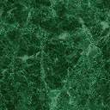
*In our project we cover many more topics on C++ programming Language. Such as :- 1. Data Types 2. Data Variables 3. If else Statements 4. Object Oriented Programming 5. Inheritance 6. Polymorphism 7. Abstract 8. Encapsulation 9. Files

Slide 9

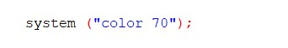
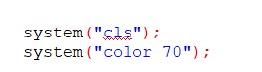
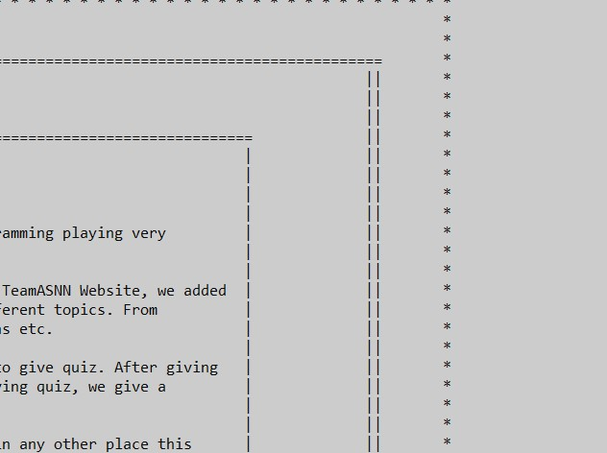
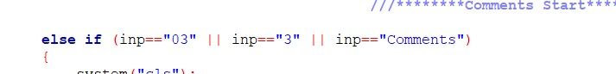
Output
* System function used for Color & Page closing system
* If else statement used for index page controlling

Slide 10

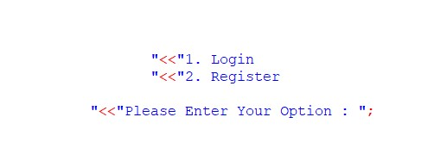
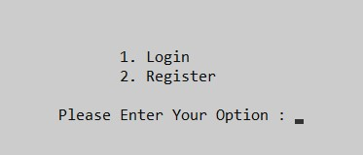
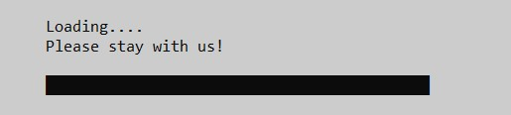
Output
* Login register option for quiz section
* We shows a loading animation for index page

Slide 11

Thank you

